Slide 1
4.1 Types of software and interrupts
Operating systems – Part 2

Slide 2
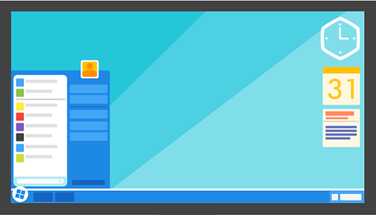

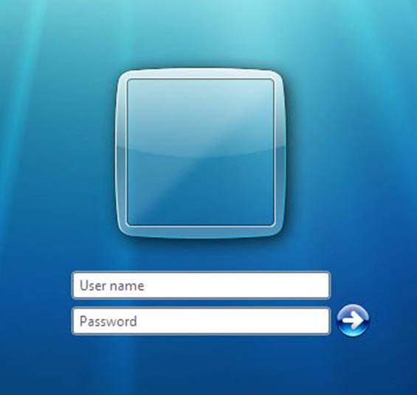
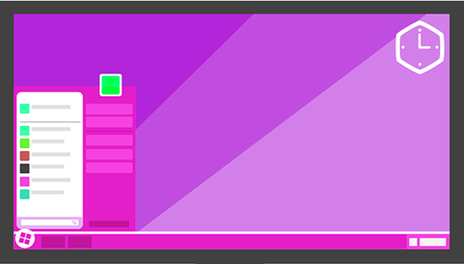
User management/security
User management: Allows multiple users to log into the same computer.
The operating system will retain settings for each user such as icons, desktop backgrounds, etc.
Each user may have different access rights to files and programs.
A client-server network may impose a fixed or roaming profile for a user and manage login requests to the network.
Craig
Dave

Slide 3
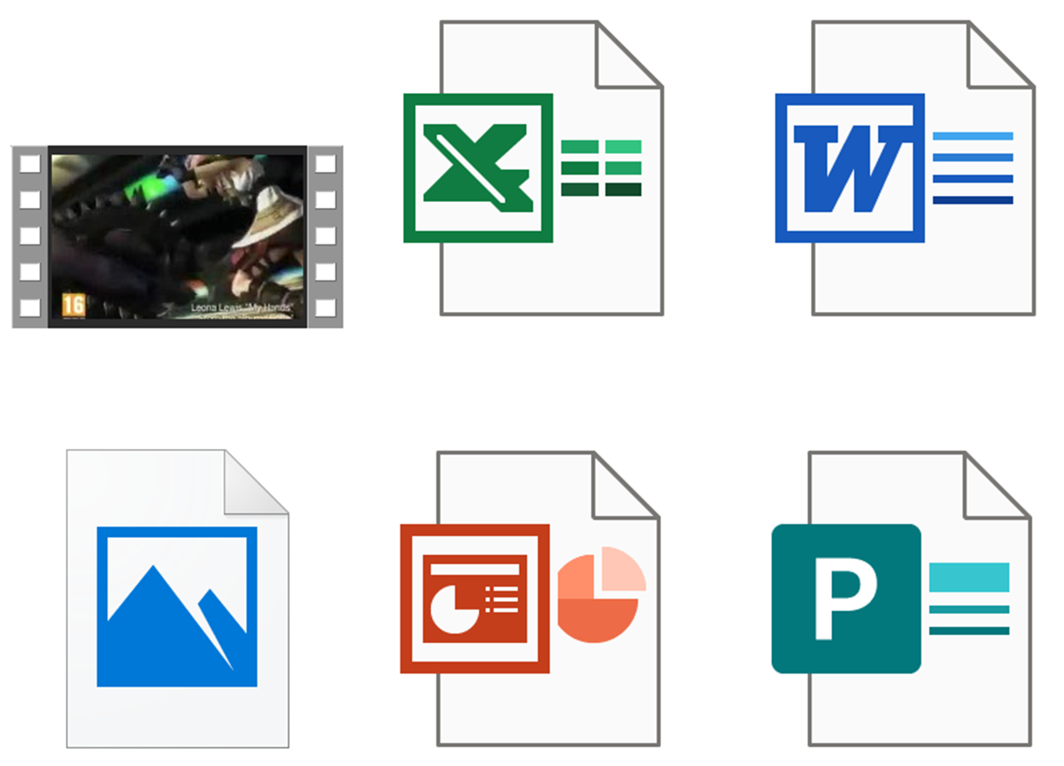
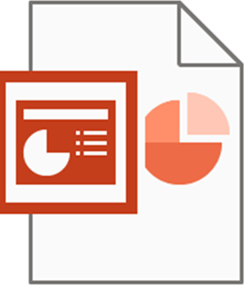
File management
Data is stored in files.
An extension to the filename tells the operating system which application to load the file into.
Film.avi
Spreadsheet.xls
Essay.docx
Cat.bmp
My holiday.pptx
Poster.pubx

Slide 4
File management
Data is stored in files.
An extension to the filename tells the operating system which application to load the file into.
Film.avi
Spreadsheet.xls
Essay.docx
Cat.bmp
My holiday.pptx
Poster.pubx

Slide 5
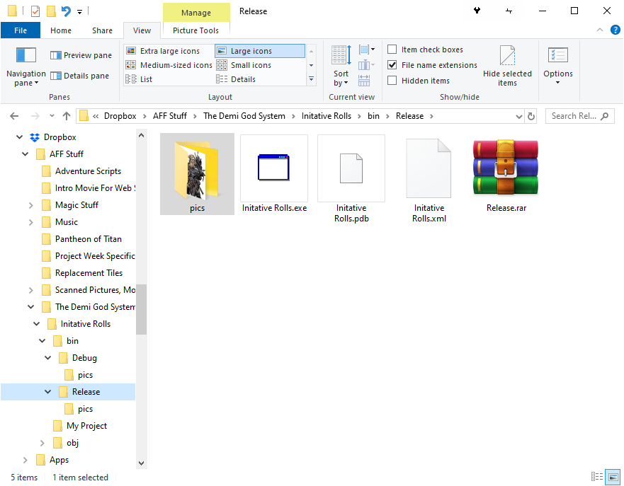
File management
The operating system presents a logical structure of files in folders and allows the user to rename, delete, copy and move files.

Slide 6

Operating systems
User management/security
Allowing different users to log into their own account with a username and password.
Each account can be granted different levels of access depending on personal needs/security policies.
The operating system can log user access, who logs on and off, when and from which device, as well as logging them off after a set length of time.
File management
Create files/folders
Delete files/folder
Move and organise files/folders
Copy files/folders
Easily search for files
Restore deleted files
Resolve file conflicts between users

Slide 7


